Slide 1

Virtual and Augmented Reality for Community Preparedness to Disasters
Part II
Qi Sun, Immersive Computing Lab, NYU
Luis Ceferino, Disaster Risk Analysis Lab, NYU
World Bank’s Global Program for Safer Schools (GPSS)
Team: Yifan Zhang, Qinchan Li, Yuanbo Zhang, Punit Vats

Slide 2
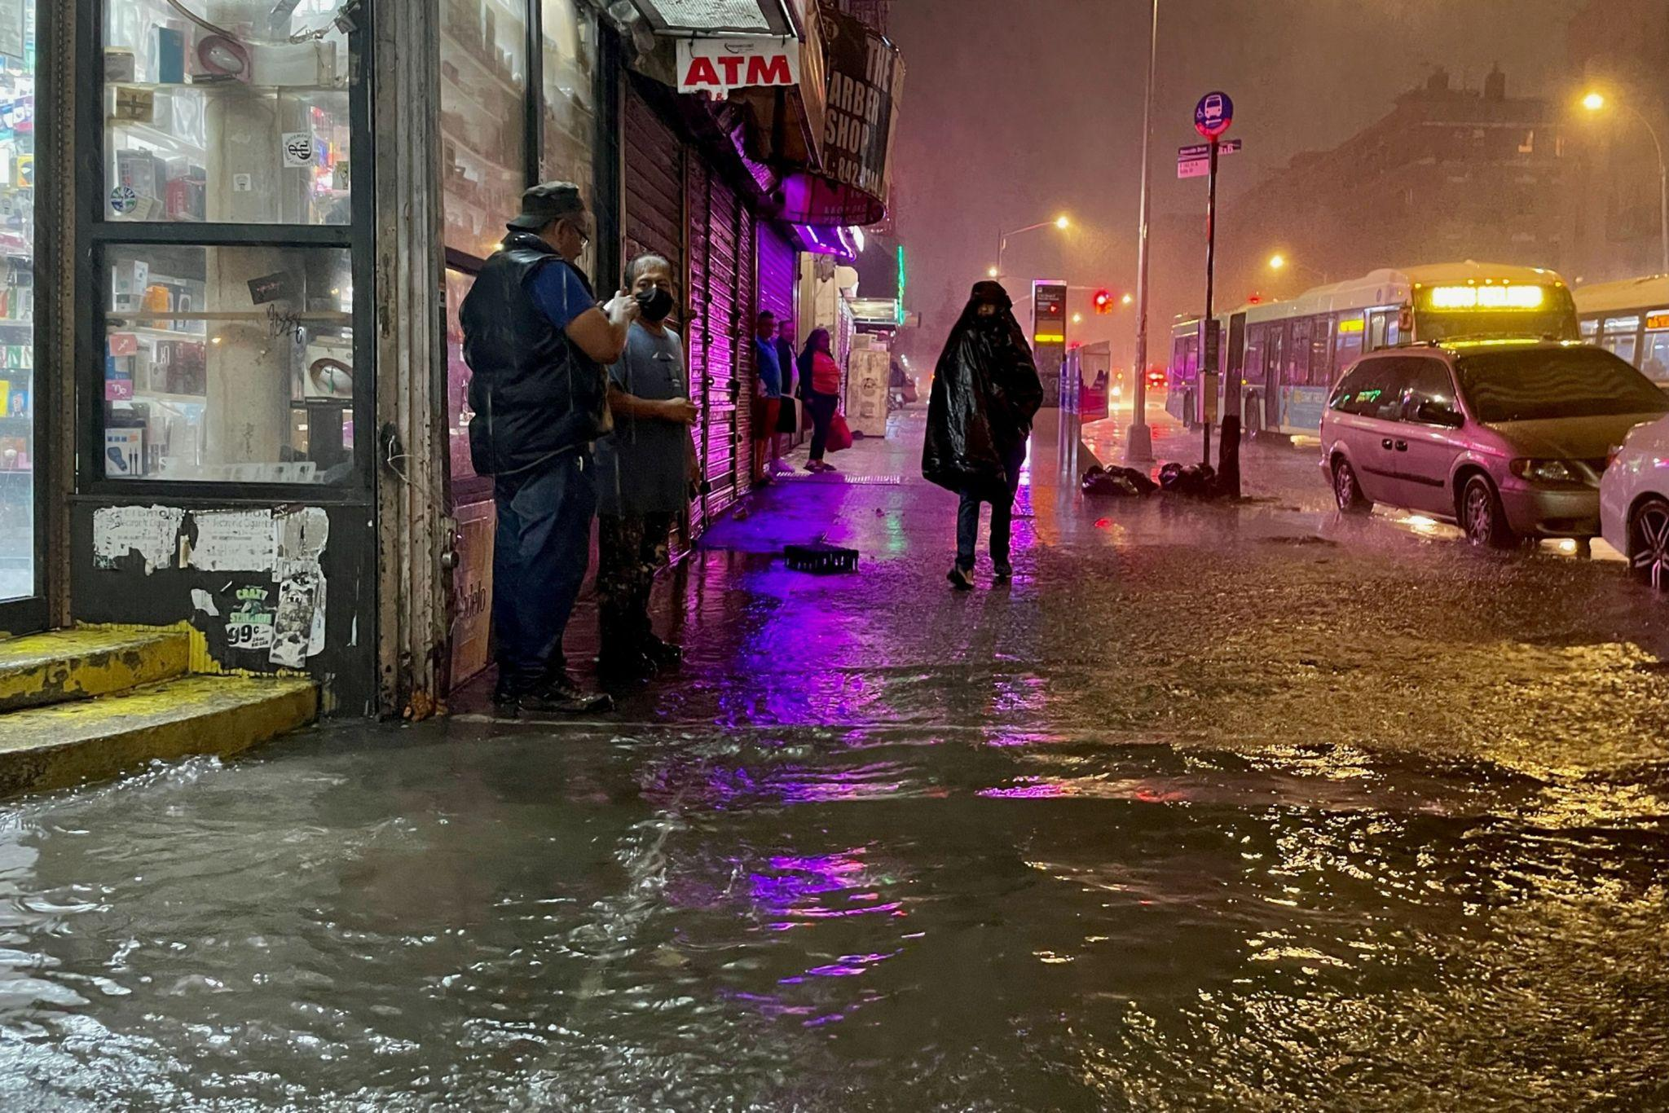
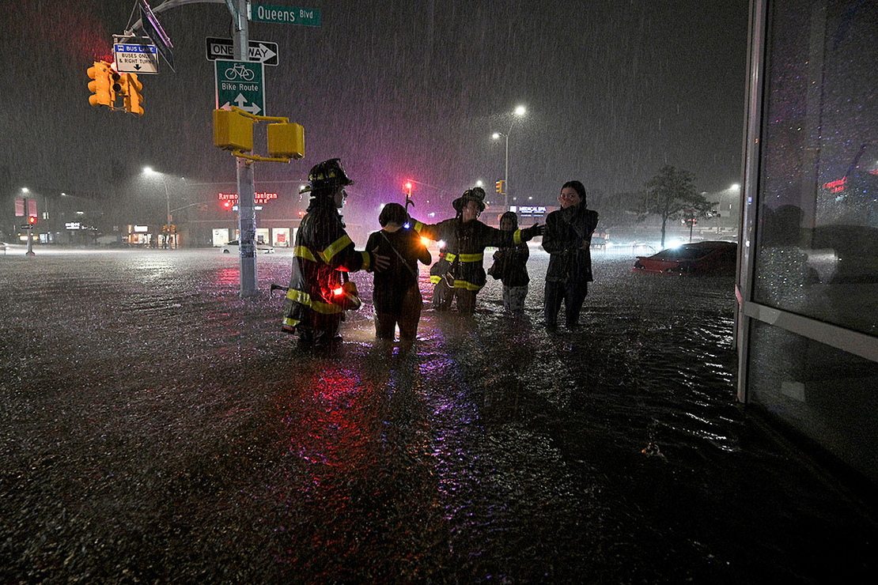
Ida in New York
43 fatalities
7 inches of rain fell in five-hour period
$50 million in damages

Slide 3
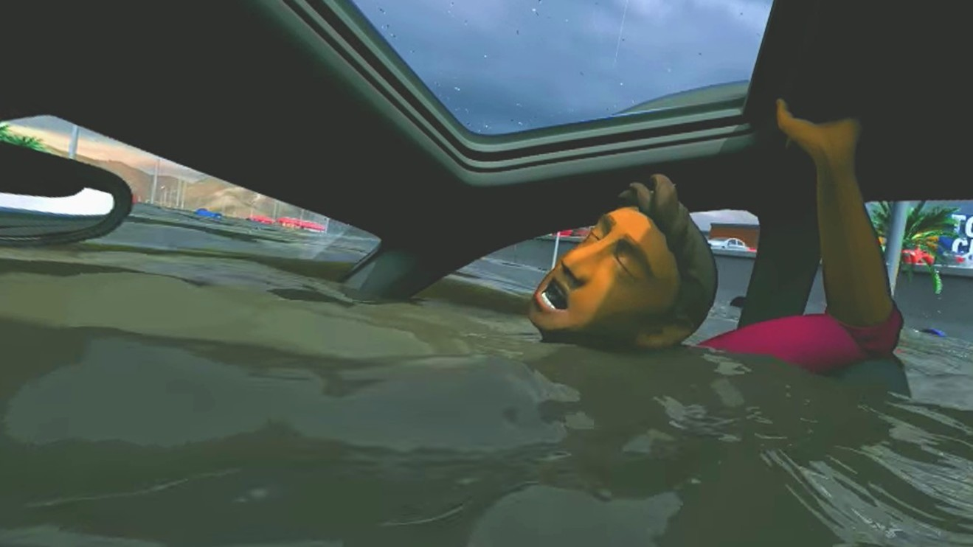
1.7 million
citizens’ property is at risk

Slide 4
Experience the disaster, prepare for the future with VR
Introduction
This work introduces a new alternative: using virtual reality to observe people's actions and the effectiveness of different scenarios of flood. Through these observations, we aim to create a better alarm system, offering citizens greater safety in the face of disasters.
Furthermore, we seek to demonstrate that virtual reality can effectively simulate other urban studies. In summary, we are exploring whether VR can provide a much safer method of collecting data on disaster preparedness and provide it to policy makers to create better safety measures.

Slide 5
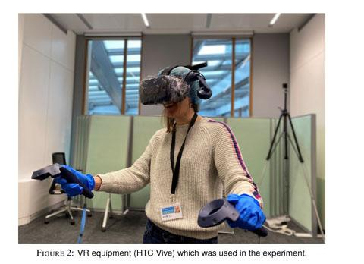
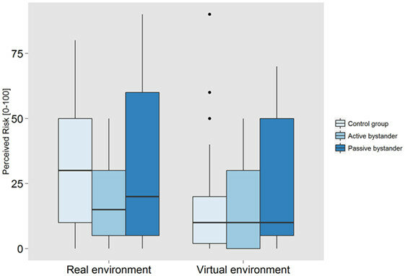
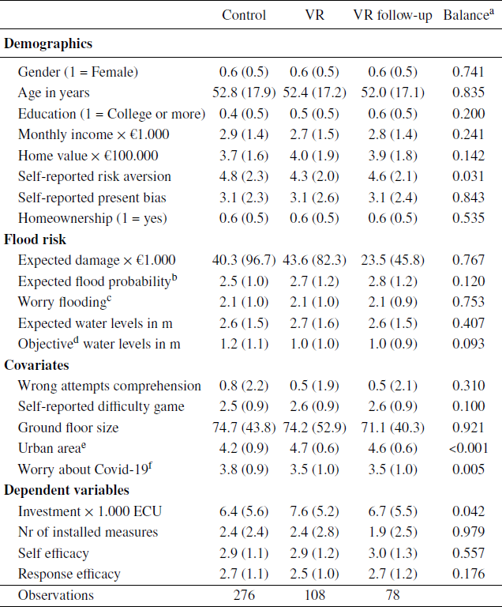
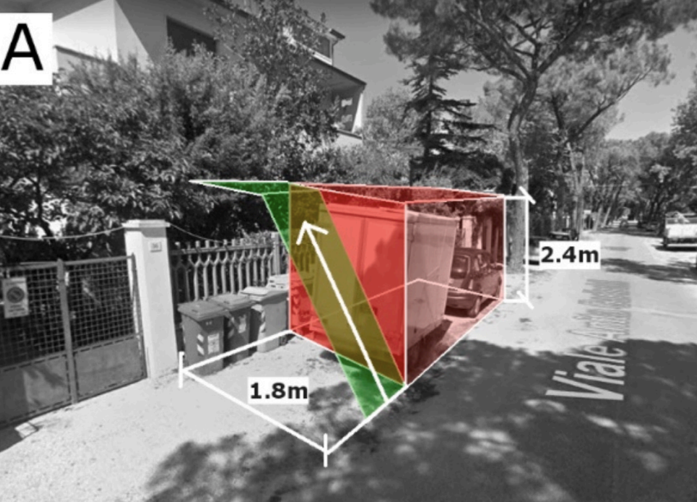
Literature Review
VR in Disaster Management: VR is a powerful tool for simulating and studying floods, aiding in public awareness and preparedness.
VR's Impact on Risk Perception (Wang et al., 2019 & Kinateder et al., 2013): VR elicits realistic emotional responses and behaviours, shaping risk perception and decision-making.
VR's Influence on Evacuation Decisions (Fujimi & Fujimura, 2020): Changes in VR flood views and increased information cues can prompt earlier evacuation decisions.
Flood Evacuation Strategies (Bernardini et al., 2020): VR studies show that water levels impact evacuation speed, informing on safe levels for successful evacuation.

Slide 6
VR Development
Environment and challenges

Slide 7
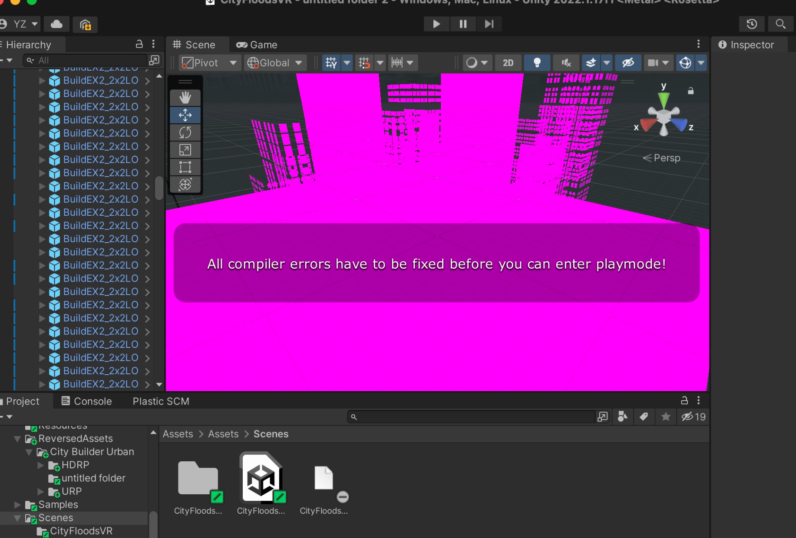
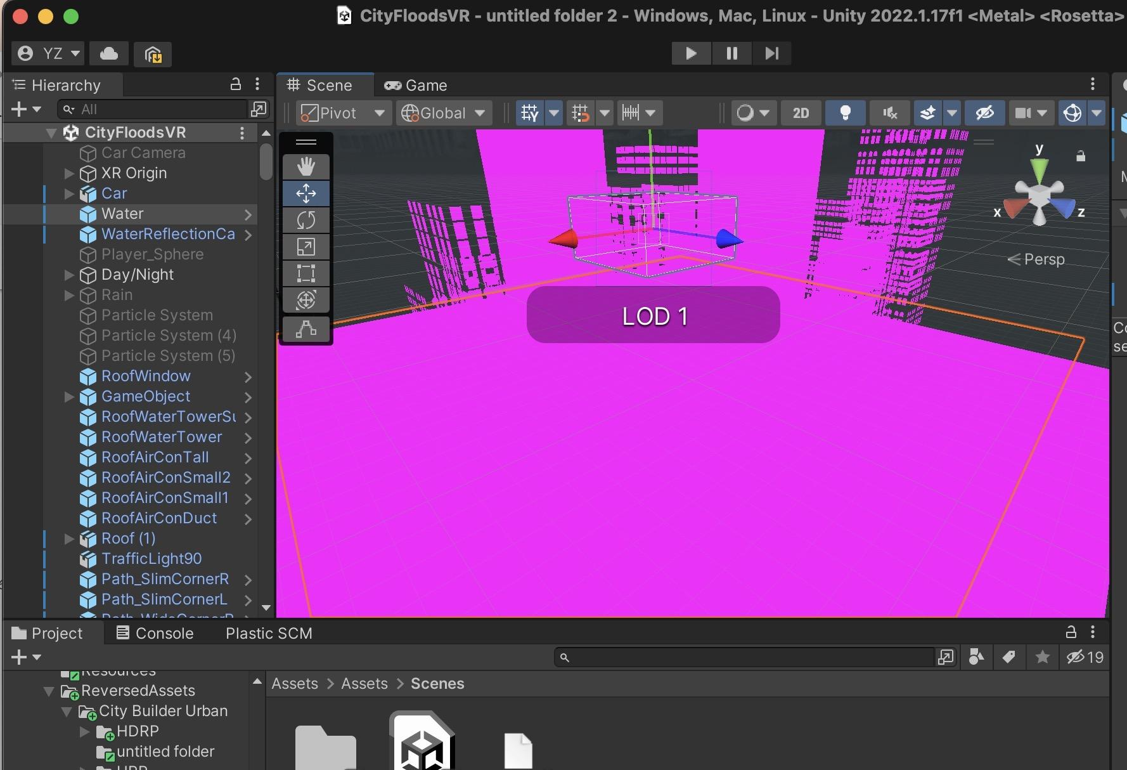
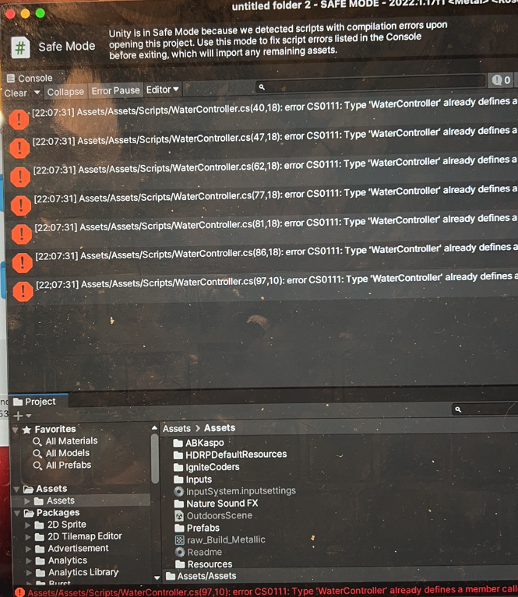
Minor
roadblocks
such as
asset sourcing
and
bugs
but we have overcome them
VR Development

Slide 8
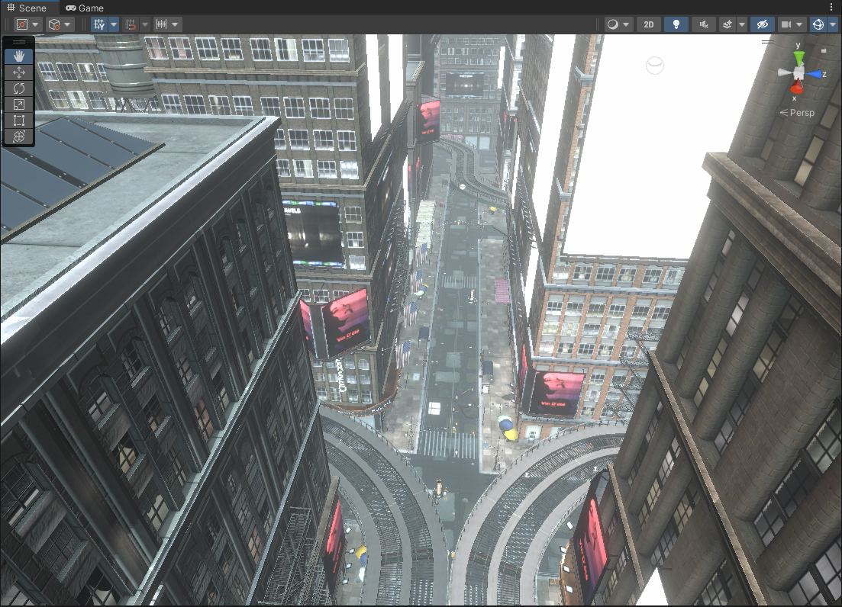
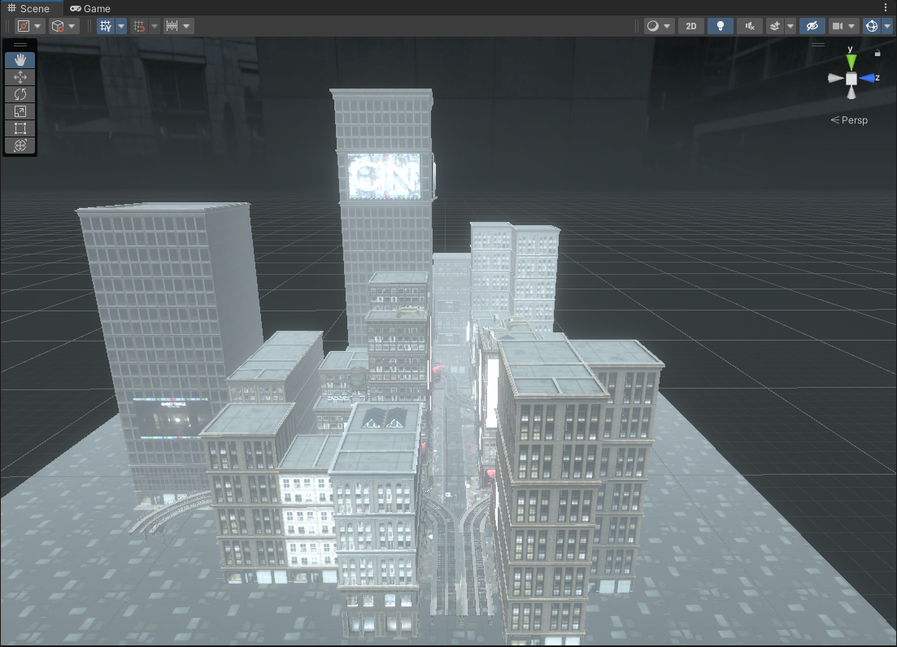
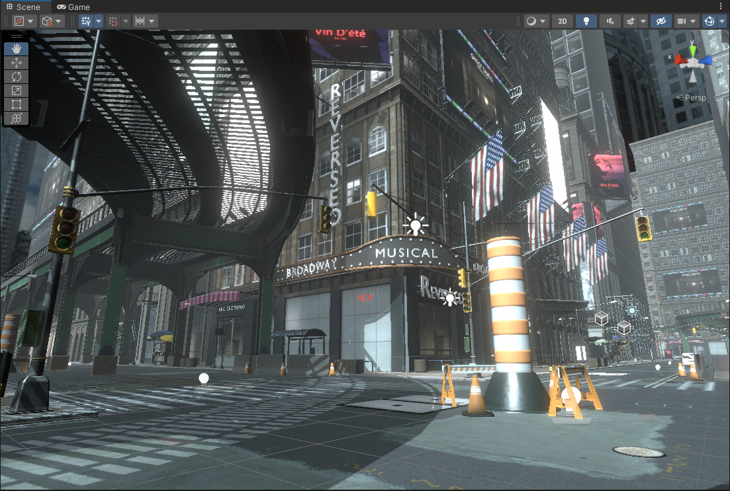
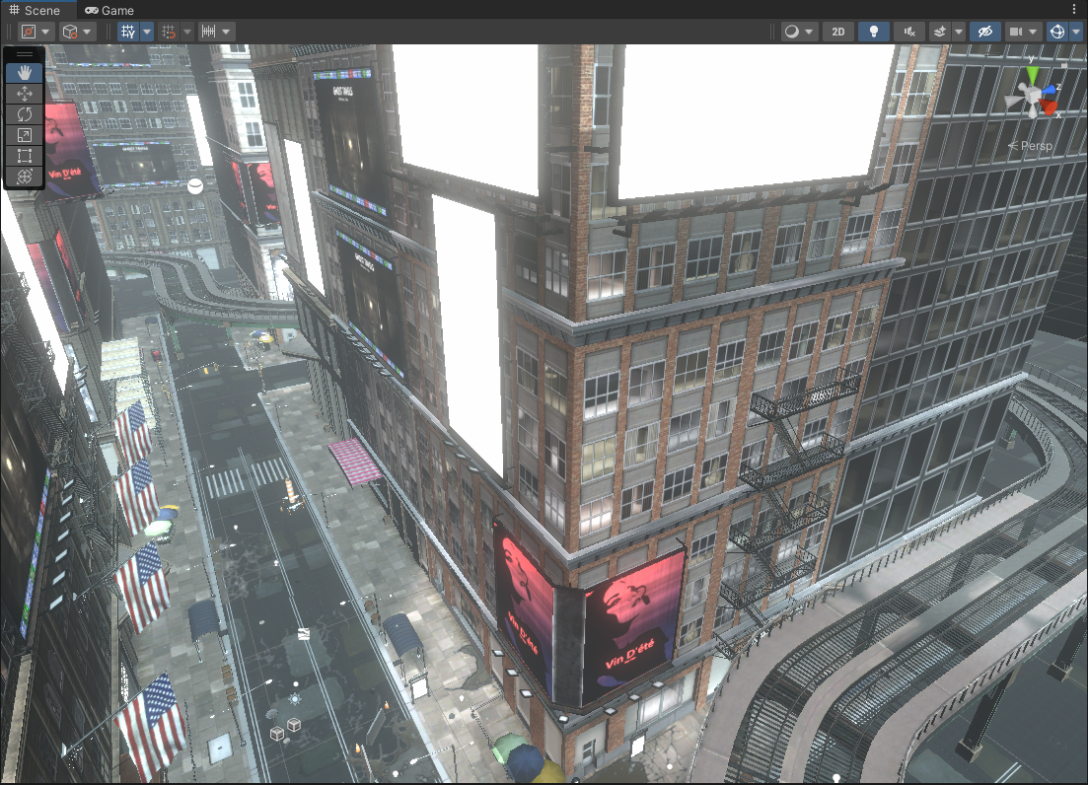
Screenshot of scenes

Slide 9
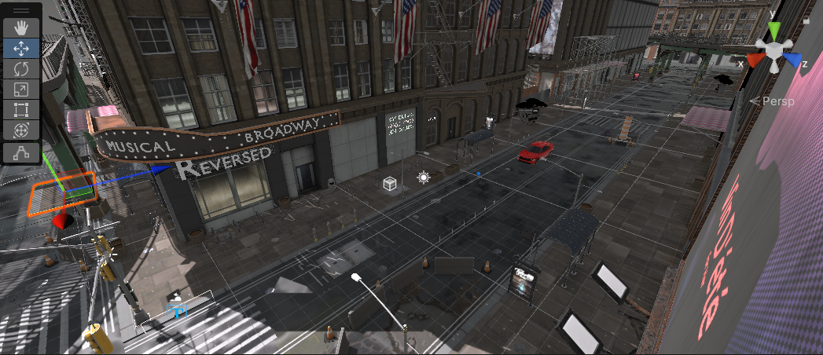
Camera Position

Slide 10
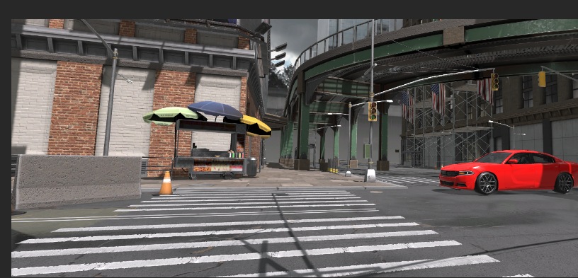
Water Controller

Slide 11
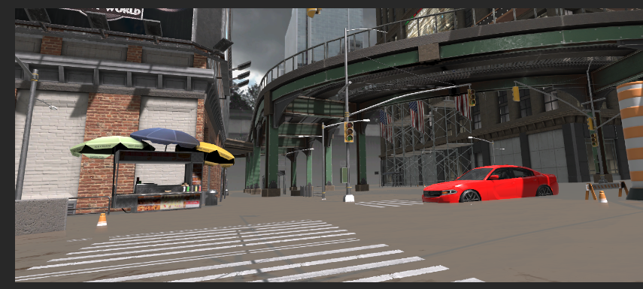
Water Controller

Slide 12
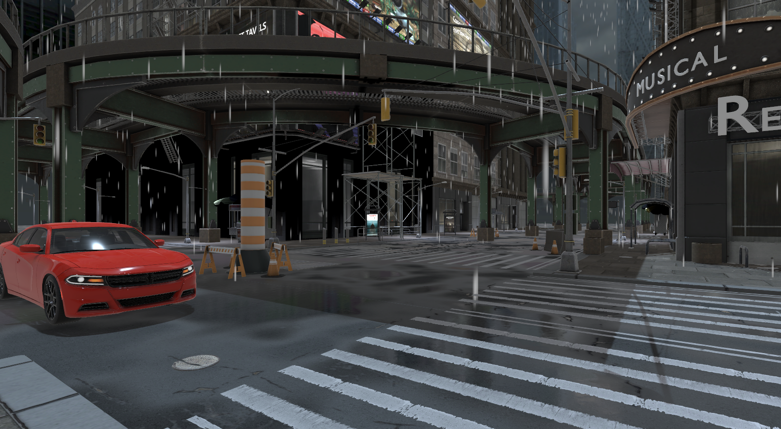
Rain Controller

Slide 13

Unity Demonstration

Slide 14
Rationality
Limitation
The realism of the rain process, background sounds, and the alarm is sufficient.
The operation is simple.
The city scene modelling is realistic
Interactive operations, such as walking and driving, have limitations due to control
Bugs and technical issues, such as walking through walls, affecting the overall user experience.
Some hardware problems exist. The headset of Oculus Quest 2 is too heavy, affecting the experience.

Slide 15
Experiment Design
A Realistic Interactive Virtual Environment for Flooding

Slide 16
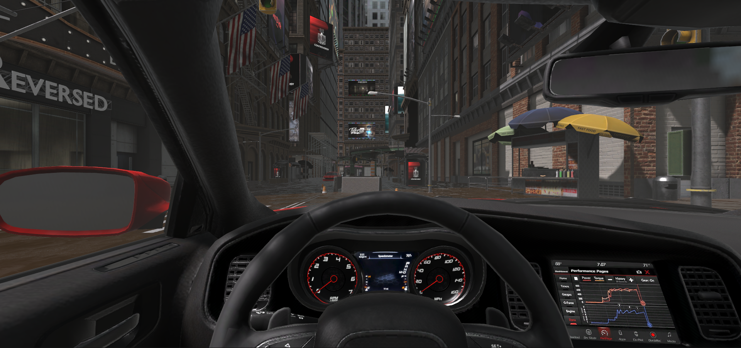

Experiment Design
Purpose：
Observe people’s evacuation choices when facing floods
Observe how different factors and warning methods impact people’s evacuation choices.
There will be 12 (2*2*3) conditions for each participant to experience
2 different views:
Walking View / Driving View
2 different light conditions:
Day / Night
3 warning methods:
Without any notice
With voice broadcasting
With alarm notice

Slide 17
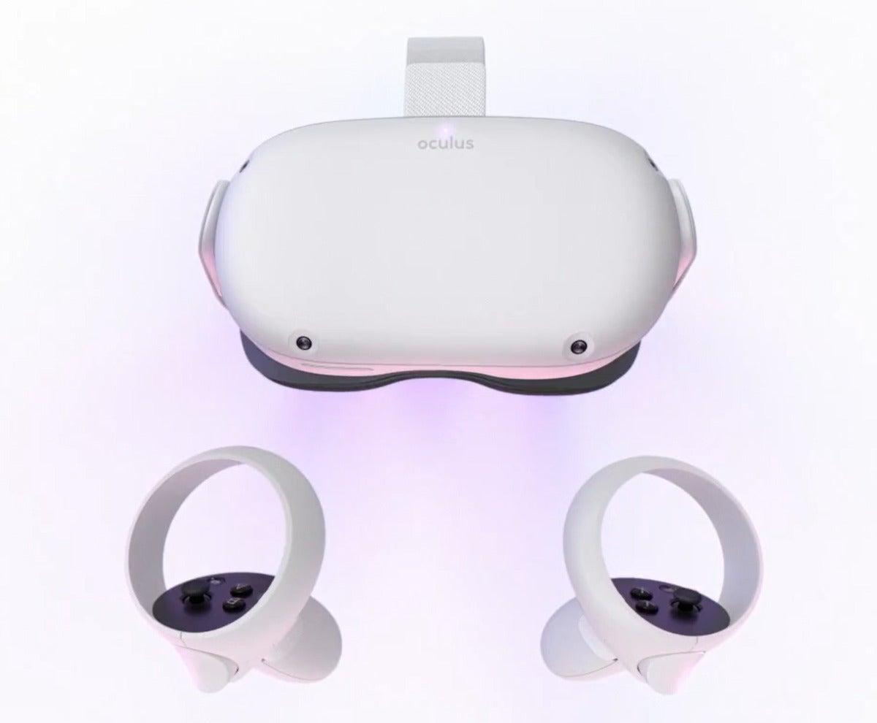
We have deployed the environment to Meta Quest 2, the VR equipment to conduct experiment.
The subjects will interact with us at 3 different times.
0 1 . The time when they noticed an abnormal amount of stagnant water
Say “Abnormal”
0 2 . The time when they feel danger.
Say “Danger”
0 3 . The time when they decide to escape.
Say “Escape”
We recorded the corresponding water depth.

Slide 18
Experiment Demonstration
Walking View

Slide 19
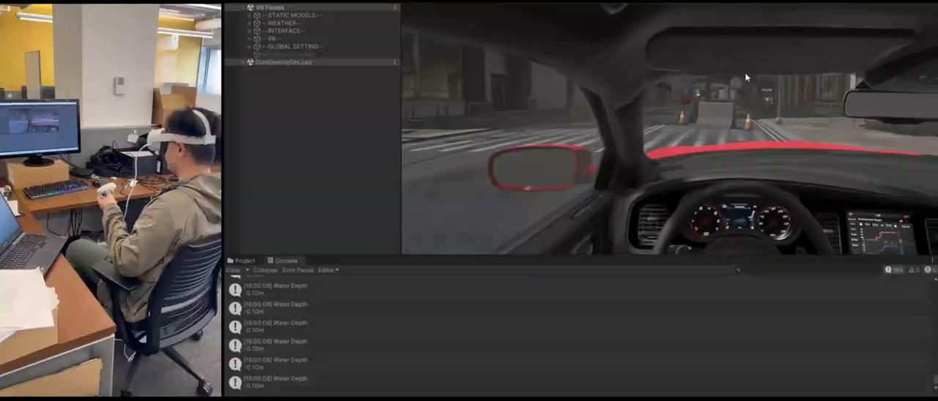
Experiment Demonstration
Driving View

Slide 20
Data and Analysis

Slide 21
Data preprocess
Due to the lack of data, each statistical test and plot is based on data that is only controlled by one condition, while all other conditions are disregarded as they are evenly distributed in the datasets divided by the controlled condition.

Slide 22
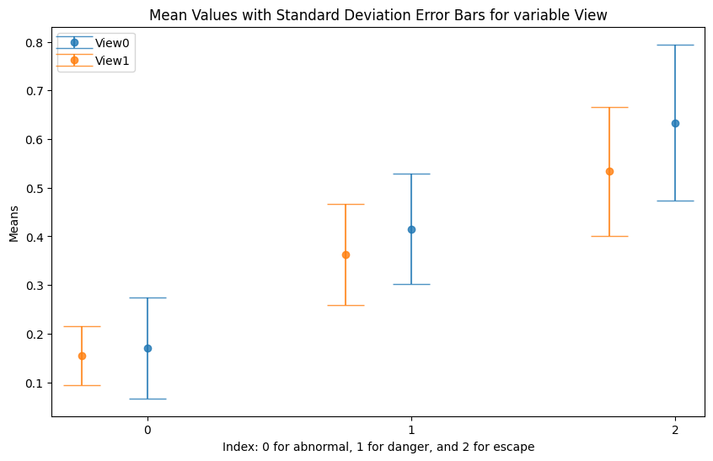
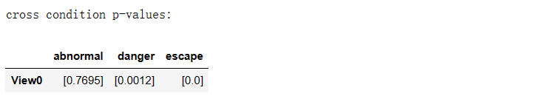
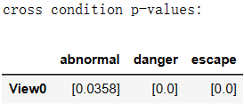
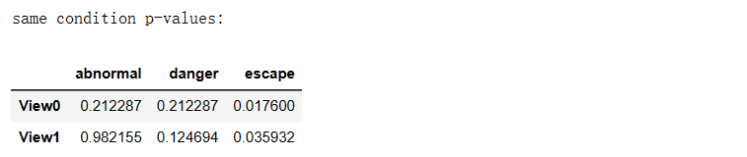
Analysis of different views
Lower the view, higher sensitivity to flooding
Car-view incurs better sensitivity towards floods in each stage except abnormal

Slide 23
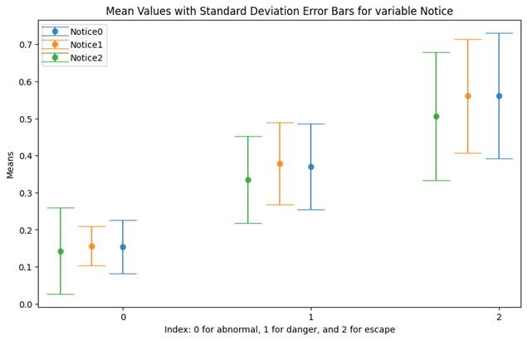

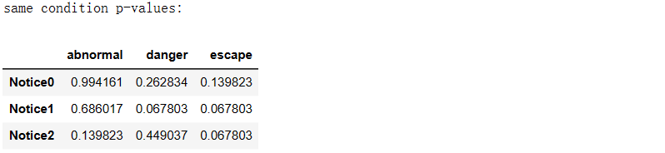
2. Analysis of different notices
Alarm in average is a better notice in the stage of danger and escape
Alarm tends to incur unstable behaviours
Evidence is not enough to say that alarm is better than no-notice

Slide 24
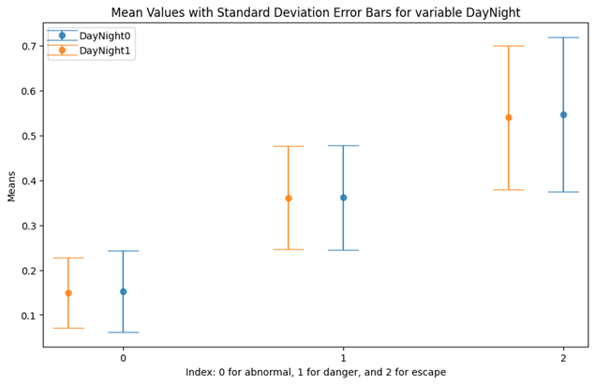

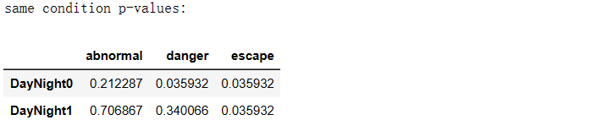
3. Analysis of different light
There is no significant difference between day light and night light

Slide 25
Concluding analysis
Users tend to behave randomly in facing danger. It might indicate that people feel panic in flooding, and VR simulation can incur this panic.
Connected with literature review, car-view might be more dangerous.
Alarm in average will be the best notice, but there is no evidence that alarm is better than no-notice in all stages. Therefore, we might recommend to deploy alarm only when the water level is deeper than abnormal.
Notice might play major role.

Slide 26
Policy Recommendations

Slide 27





Deploying Alarms Based on Water Levels
Managing Public Anxiety
Increasing Public Awareness
Organizing Flooding Evacuation Drills
Leveraging VR for Preparedness

Slide 28
Conclusions

Slide 29





Successfully deployed a flood environment in VR
Analysed human behavior towards flood
Recommendations for improved preparedness
Critical Recommendations for policymakers
Future work

Slide 30
Thank You

